Slide 1
Linux Introduction
In short

Slide 2
Basics of UNIX
UNIX is an operating system which was first developed in the 1970s, and has been under constant development ever since.
It is a stable, multi-user, multi-tasking system for servers, desktops and laptops.
UNIX systems also have a graphical user interface (GUI) similar to Microsoft Windows which provides an easy-to-use environment.
There are many different versions of UNIX, although they share common similarities.

Slide 3
The UNIX Distributions / Distros
AIX by IBM
BSD/OS (BSDi) by Wind River
HP-UX by Hewlett-Packard Company
OpenBSD by OpenBSD Group
Solaris by Sun Microsystems (Oracle)
IRIX by Silicon Graphics, Inc.
Tru64 UNIX
FreeBSD
NetBSD
Mac OS

Slide 4

Beginning of LINUX
The history of Linux began in 1991 with the commencement of a personal project by Finnish student Linus B. Torvalds to create a new free operating system kernel.
The initial release of its source code in September 17, 1991, which is still getting improved day by day.
Linus Torvalds had wanted to call his invention Freax, ("free", "freak", and "x“).
Linus wrote the program specifically for the hardware he was using and independent of an operating system because he wanted to use the functions of his new PC with an 80386 processor.

Slide 5
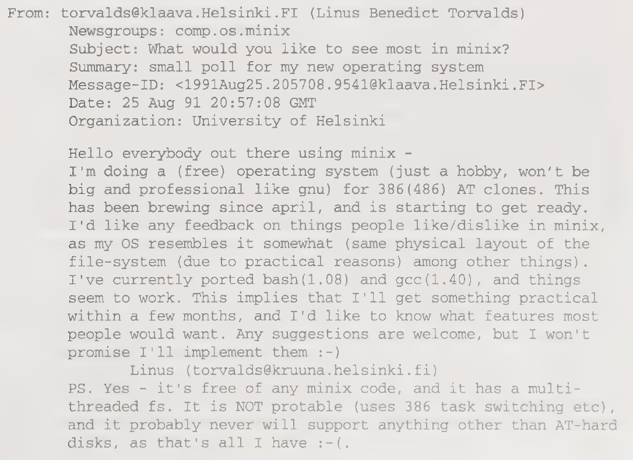
Message from Linus Torvalds

Slide 6
Why to choose LINUX ?
Easy to install applications
Secure
Easy to change options → Graphical Machines (GUI)
Community
Free
Portable
Open Source
Multi-User Hierarchical File System (FHS)

Slide 7

I AM TUX !!!
Torvalds announced in 1996 that there would be a mascot for Linux, a Penguin.
This was due to the fact when they were about to select the mascot, Torvalds did mention he was bitten by a little penguin
It is also known as TUX (Torwalds UniX)

Slide 8
The Kernel
All operating systems have kernels.
The Linux kernel is unique and flexible because it is also modular in nature.
The kernel of the Window operating system is a solidly connected piece of code, unable to be easily broken up into pieces.
This modularity is significant to the success of Linux. The ability to scale down (or up) to meet the needs of a specific platform is a big advantage over other operating systems constrained to just a few possible platforms
Latest stable kernel version is 4.7.3

Slide 9
The Shell
The shell provides you with an interface to the UNIX system.
It gathers input from you and executes programs based on that input. When a program finishes executing, it displays that program's output.
A shell is an environment in which we can run our commands, programs, and shell scripts.
In UNIX there are two major types of shells:
The Bourne shell. If you are using a Bourne-type shell, the default prompt is the $ character.
The C shell. If you are using a C-type shell, the default prompt is the % character.
There are again various subcategories for Bourne Shell which are listed as follows −
Bourne shell ( sh)
Korn shell ( ksh)
Bourne Again shell ( bash) – commonly used.

Slide 10
Linux Environments
The windows, menus, and dialog boxes known as the windowing system and the desktop environment.
These layers provide the human-oriented graphical user interface (GUI).
In Linux, there a lot of choices for which windowing system and desktop environment can be used, something that Linux allows users to decide.
Unity
GNOME
KDE
XFCE
Cinnamon
MATE
LXDE
XMONAD

Slide 11
Linux Distributions
Ubuntu
Linux Mint
Debian
Fedora
OpenSUSE / SUSE Linux Enterprise
Mandriva
Puppy Linux
Slackware Linux
Arch Linux
Red Hat Enterprise Linux / CentOS
CentOS is a community, that uses RedHat code.

Slide 12
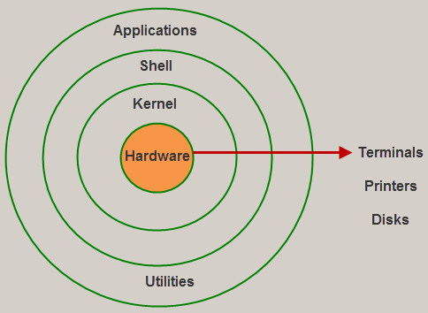
Linux Architecture

Slide 13
Linux Principle
Everything is a file. ( Including hardware )
The UNIX security model is based around the security of files.
By treating everything as a file, a consistency emerges.
You can secure access to hardware in the same way as your secure access to a document.
Small, single-purpose programs.
UNIX provides many small utilities that perform one task very well.
When new functionality is required, the general philosophy is to create a separate program – rather than to extend an existing utility with new features.

Slide 14
Linux Principle (conti.)
3. Ability to chain programs together to perform complex tasks.
A core design feature of UNIX is that the output of one program can be the input for another.
This gives the user the flexibility to combine many small programs together to perform a larger, more complex task.
4. Avoid captive user interfaces.
Interactive commands are rare in UNIX.
Most commands expect their options and arguments to be typed on the command line when the command is launched.
5. Configuration data stored in text
Text is a universal interface, and many UNIX utilities exist to manipulate text.
Storing configuration in text allows an administrator to move a configuration from one machine to another easily.

Slide 15
Booting process in LINUX
Power On
Logon Screen
BIOS
Run Level
MBR
INIT / Systemd
GRUB
Kernel

Slide 16
BIOS (Basic Input Output System)
Responsible for searching, loading & executing the boot loader program.
Searches boot loader in HDD, SD card, CD/DVD.
Once loaded into memory, it gives the control to MBR.
BIOS loads & executes the MBR

Slide 17
MBR (Master Boot Record)
Located in the 1st sector of the HDD.
Size is equal to 512 byte
446 byte = Primary boot loader info
64 byte = partition table info.
2 byte = MBR validation checks
It contains info about GRUB
It loads & executes boot loader.

Slide 18
GRUB (Grand Unified Boot loader)
Used for selecting the operating system at the time of boot up.
Has the knowledge of the file system in “/boot/grub/grub.conf”.
Grub loads & executes the ‘Kernel’ & INITRD (INITial Ram Disk image).
INITRD is used by kernel as temp root file system until kernel is booted & real root is mounted.

Slide 19
Kernel
Mounts root file system.
Executes the INIT program located in “/sbin/init”
INIT becomes the very 1st process which get executes and got PID as 1.
Loads the file systems & runs the initial (init) program.

Slide 20
INIT
It decides the run level.
System executes the program depending upon Run Level
Run Level decides which initial program be loaded at startup.
INIT 0 = Halt
INIT 1 = Single User mode / maintenance
INIT 2 = Multiuser, without NFS
INIT 3 = Full multiuser mode (CLI)
INIT 4 = unused
INIT 5 = init 3 + GUI
INIT 6 = Reboot

Slide 21
INIT
Runlevel | Description
0 | System halt i.e., the system can be safely powered off with no activity.
1 | Single user mode.
2 | Multiple user mode with no NFS (network file system).
3 | Multiple user modes under the command line interface and not under the graphical user interface.
4 | User-definable.
5 | Multiple user mode under GUI (graphical user interface) and this is the standard runlevel for most of the LINUX-based systems.
6 | Reboot which is used to restart the system.

Slide 22
RUN LEVEL EQUIVALENTS
Old runlevel | RedHat 7 `systemd` unit
runlevel0 | poweroff.target
runlevel1 | rescue.target
runlevel2 | multi-user.target
runlevel3 | multi-user.target
runlevel4 | multi-user.target
runlevel5 | graphical.target
runlevel6 | reboot.target

Slide 23
File system Hierarchy Standard (FHS)

Slide 24
File system Hierarchy Standard (FHS)

Slide 25
File system Hierarchy Standard (FHS)

Slide 26
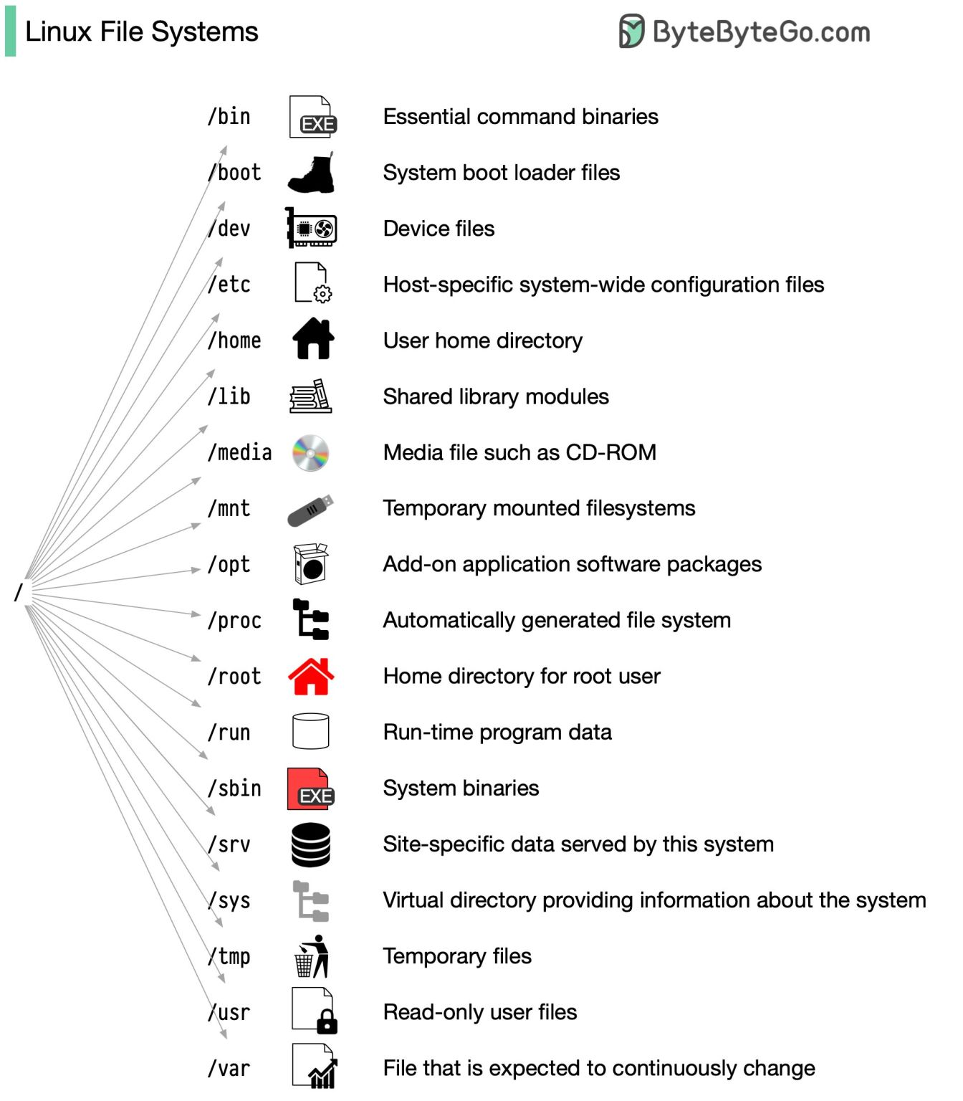
File system Hierarchy Standard (FHS)

Slide 27
RHEL 7 vs RHEL 6
Features | RHEL 7 | RHEL 6
Default File System | XFS | EXT4
Kernel Version | 3.10.xx kernel | 2.6.xx kernel
Kernel Code Name | Maipo | Santiago
First Process | systemd (process ID 1) | init (process ID 1)
Change In UID Allocation | Root → 0 to 999 Normal → 1000 & so on | Root → 0 to 499 Normal → 500 & so on
Boot Loader | GRUB 2 | GRUB 0.97
Default Database | MariaDB | MySQL

Slide 28
Difference between different file systems
 | Ext2 | Ext3 | Ext4 | XFS
Full form | 2nd extended file system | 3rd extended file system | 4th extended file system | extent file system
Introduced in | 1993 | 2001 | 2008 | 1994 with IRIX 5.3
Journaling feature | No | Yes - dedicated area | yes - but can be turned off | Yes
Individusal File size | 16 GB to 2 TB | 16 GB to 2 TB | 16 GB to 16 TB | 16 TB to 16 Exabyte
Overall File size | 2 TB to 32 TB | 2 TB to 32 TB | 1 ExaByte to 1 PetaByte | 16 TB to 18 Exabyte

Slide 29
What’s new in RHEL 7
No 32 Bit ISO Image
New Ruby and Python Versions
OpenJDK7 Made Default
More Powerful Network Manager
Support for 40 Gigabit NICs
Implementation of tmpfs file system
Minimum Disk Space for Installation of RHEL7
At least 1 GB of disk space, but 5 GB is recommended for all architecture.

Slide 30
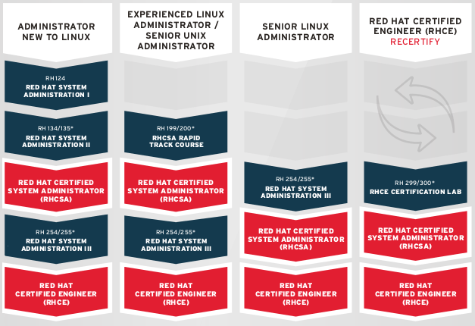
Red Hat Certification Path

